Slide 1

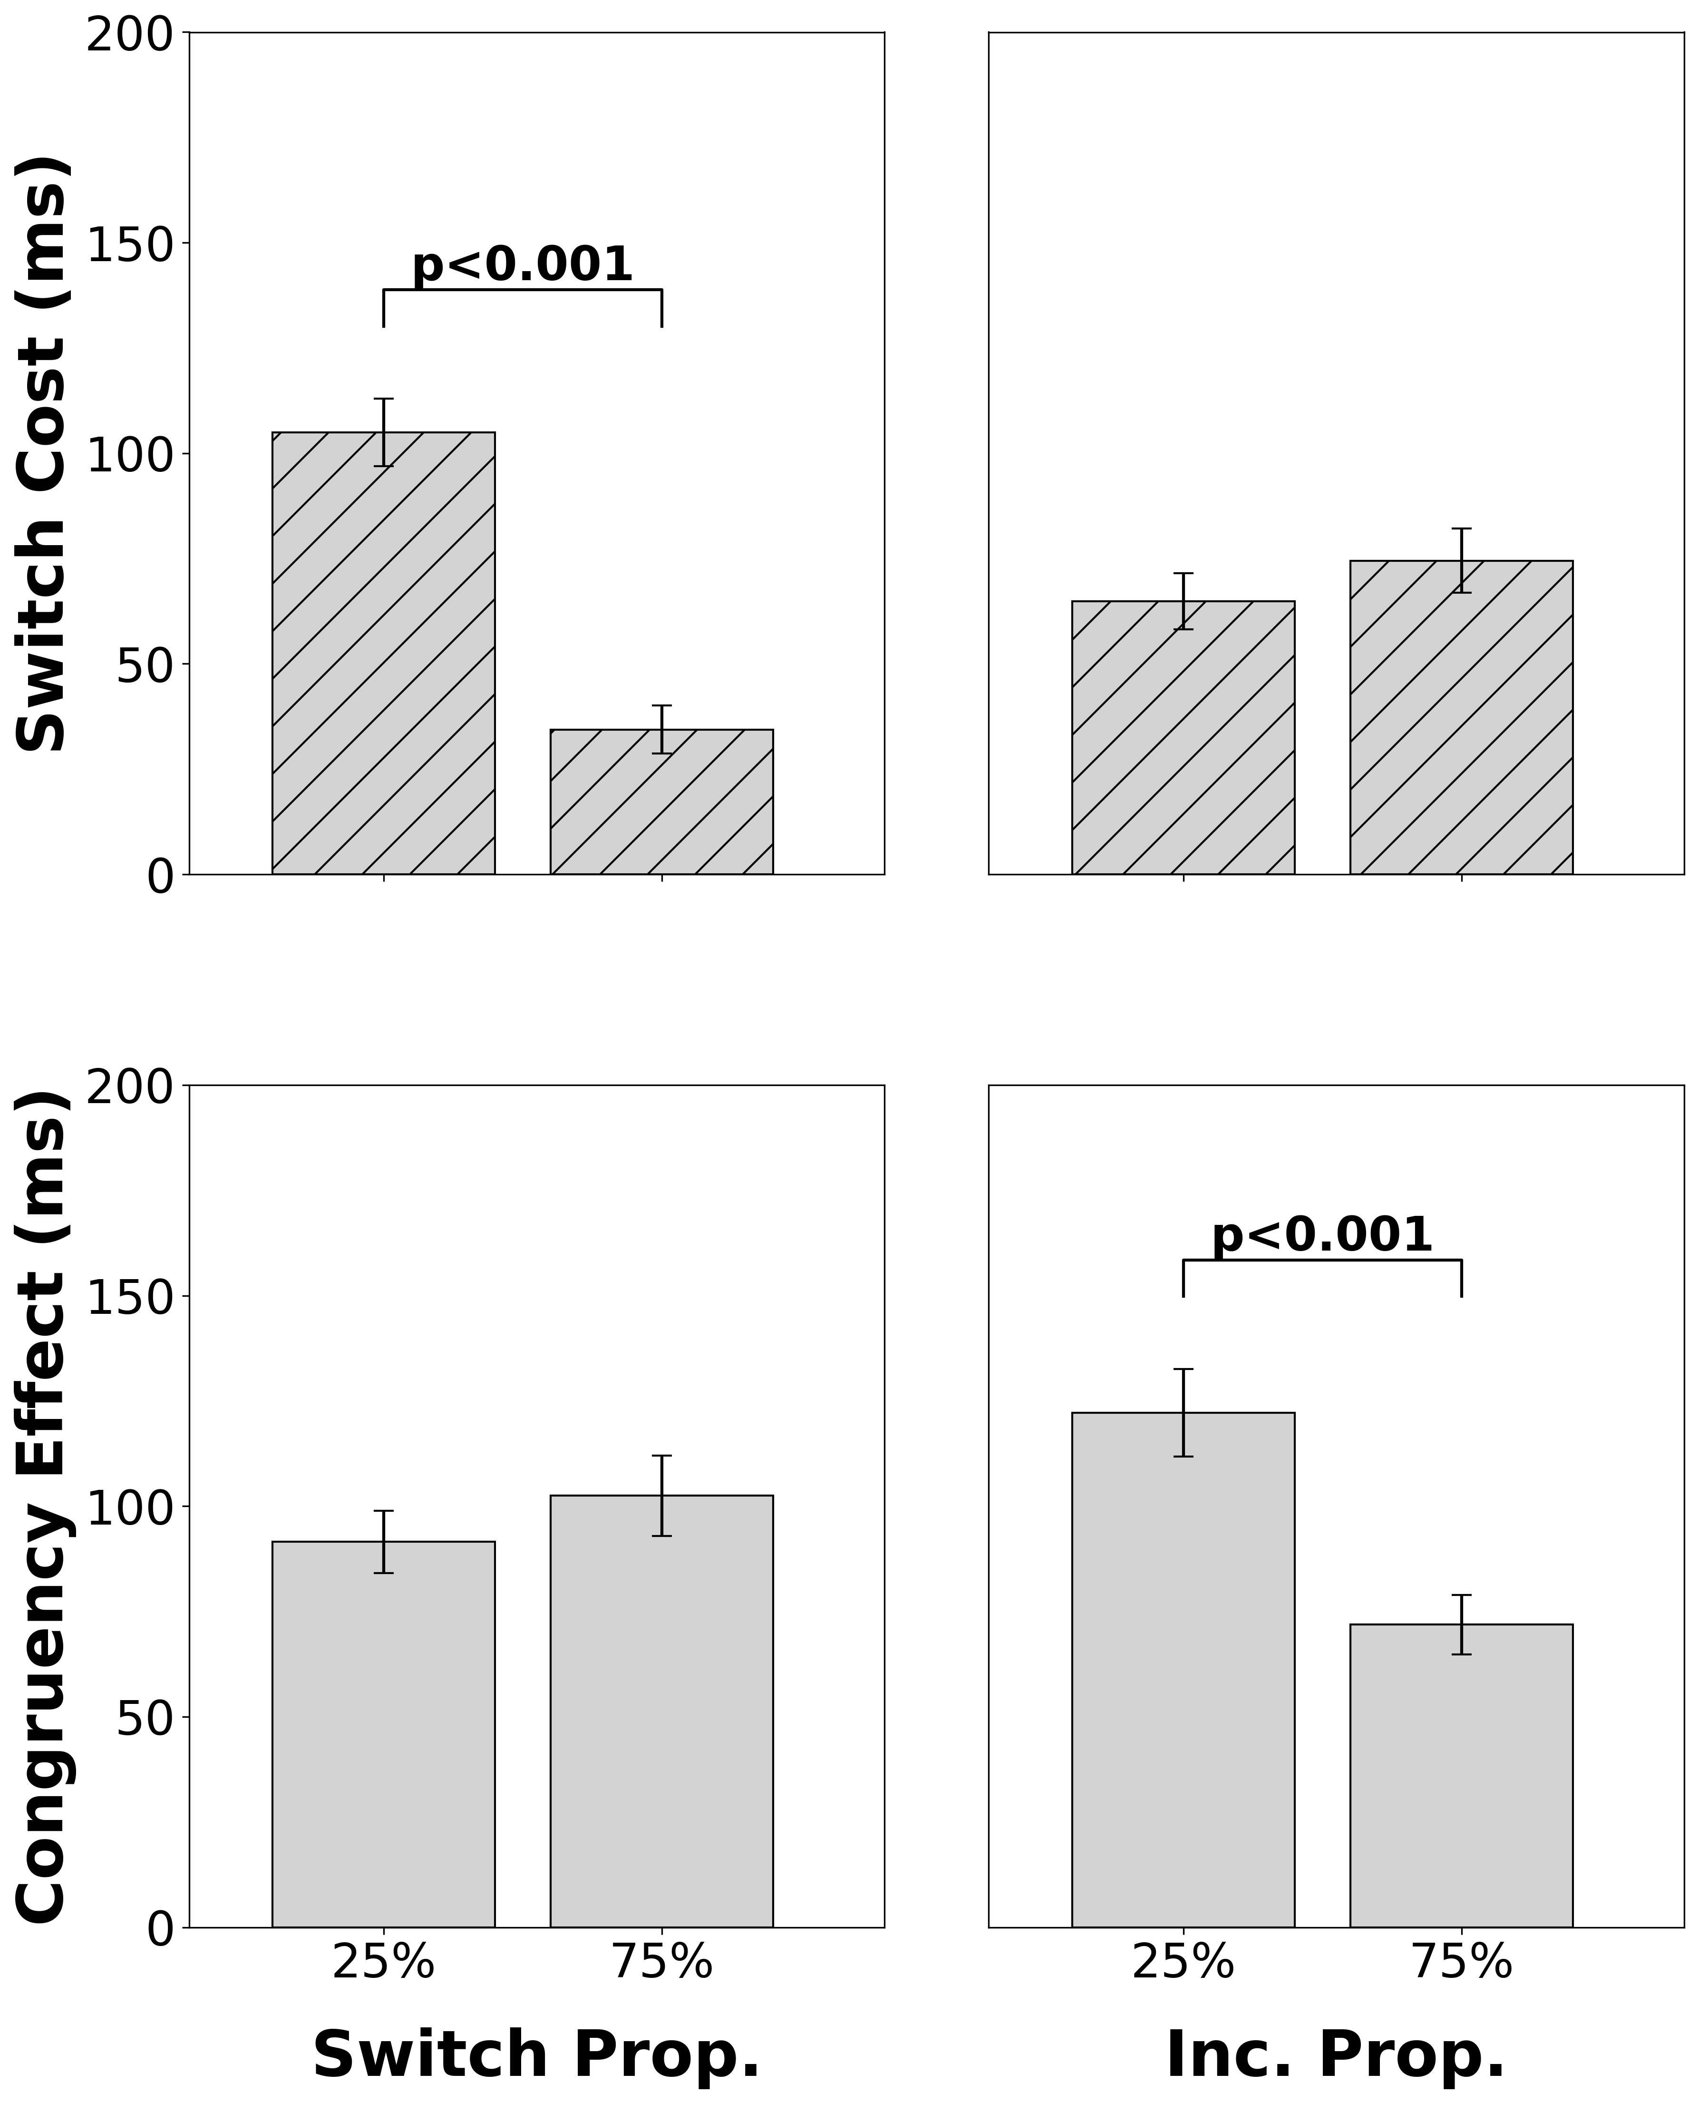
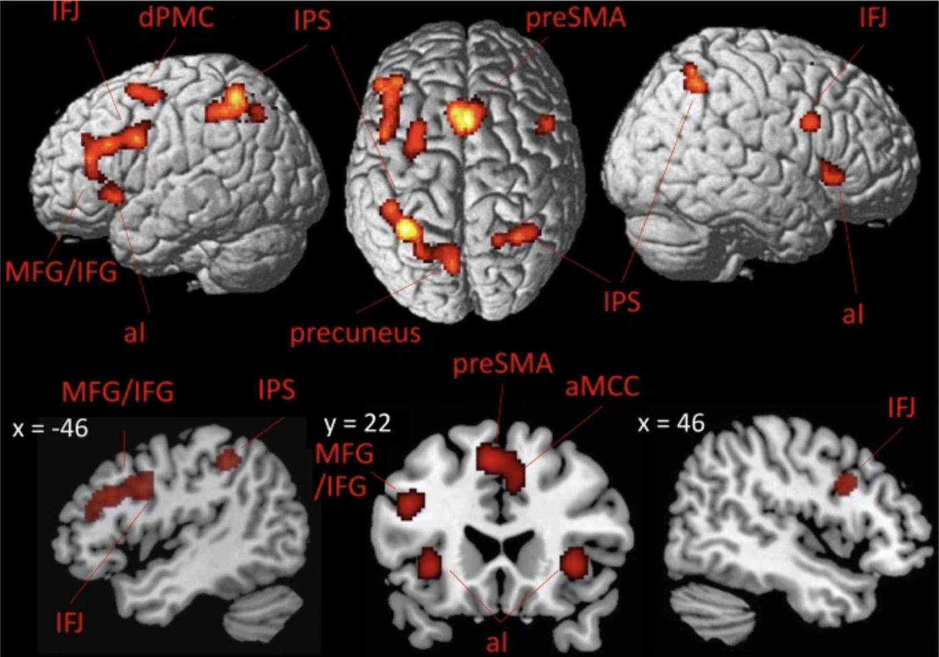
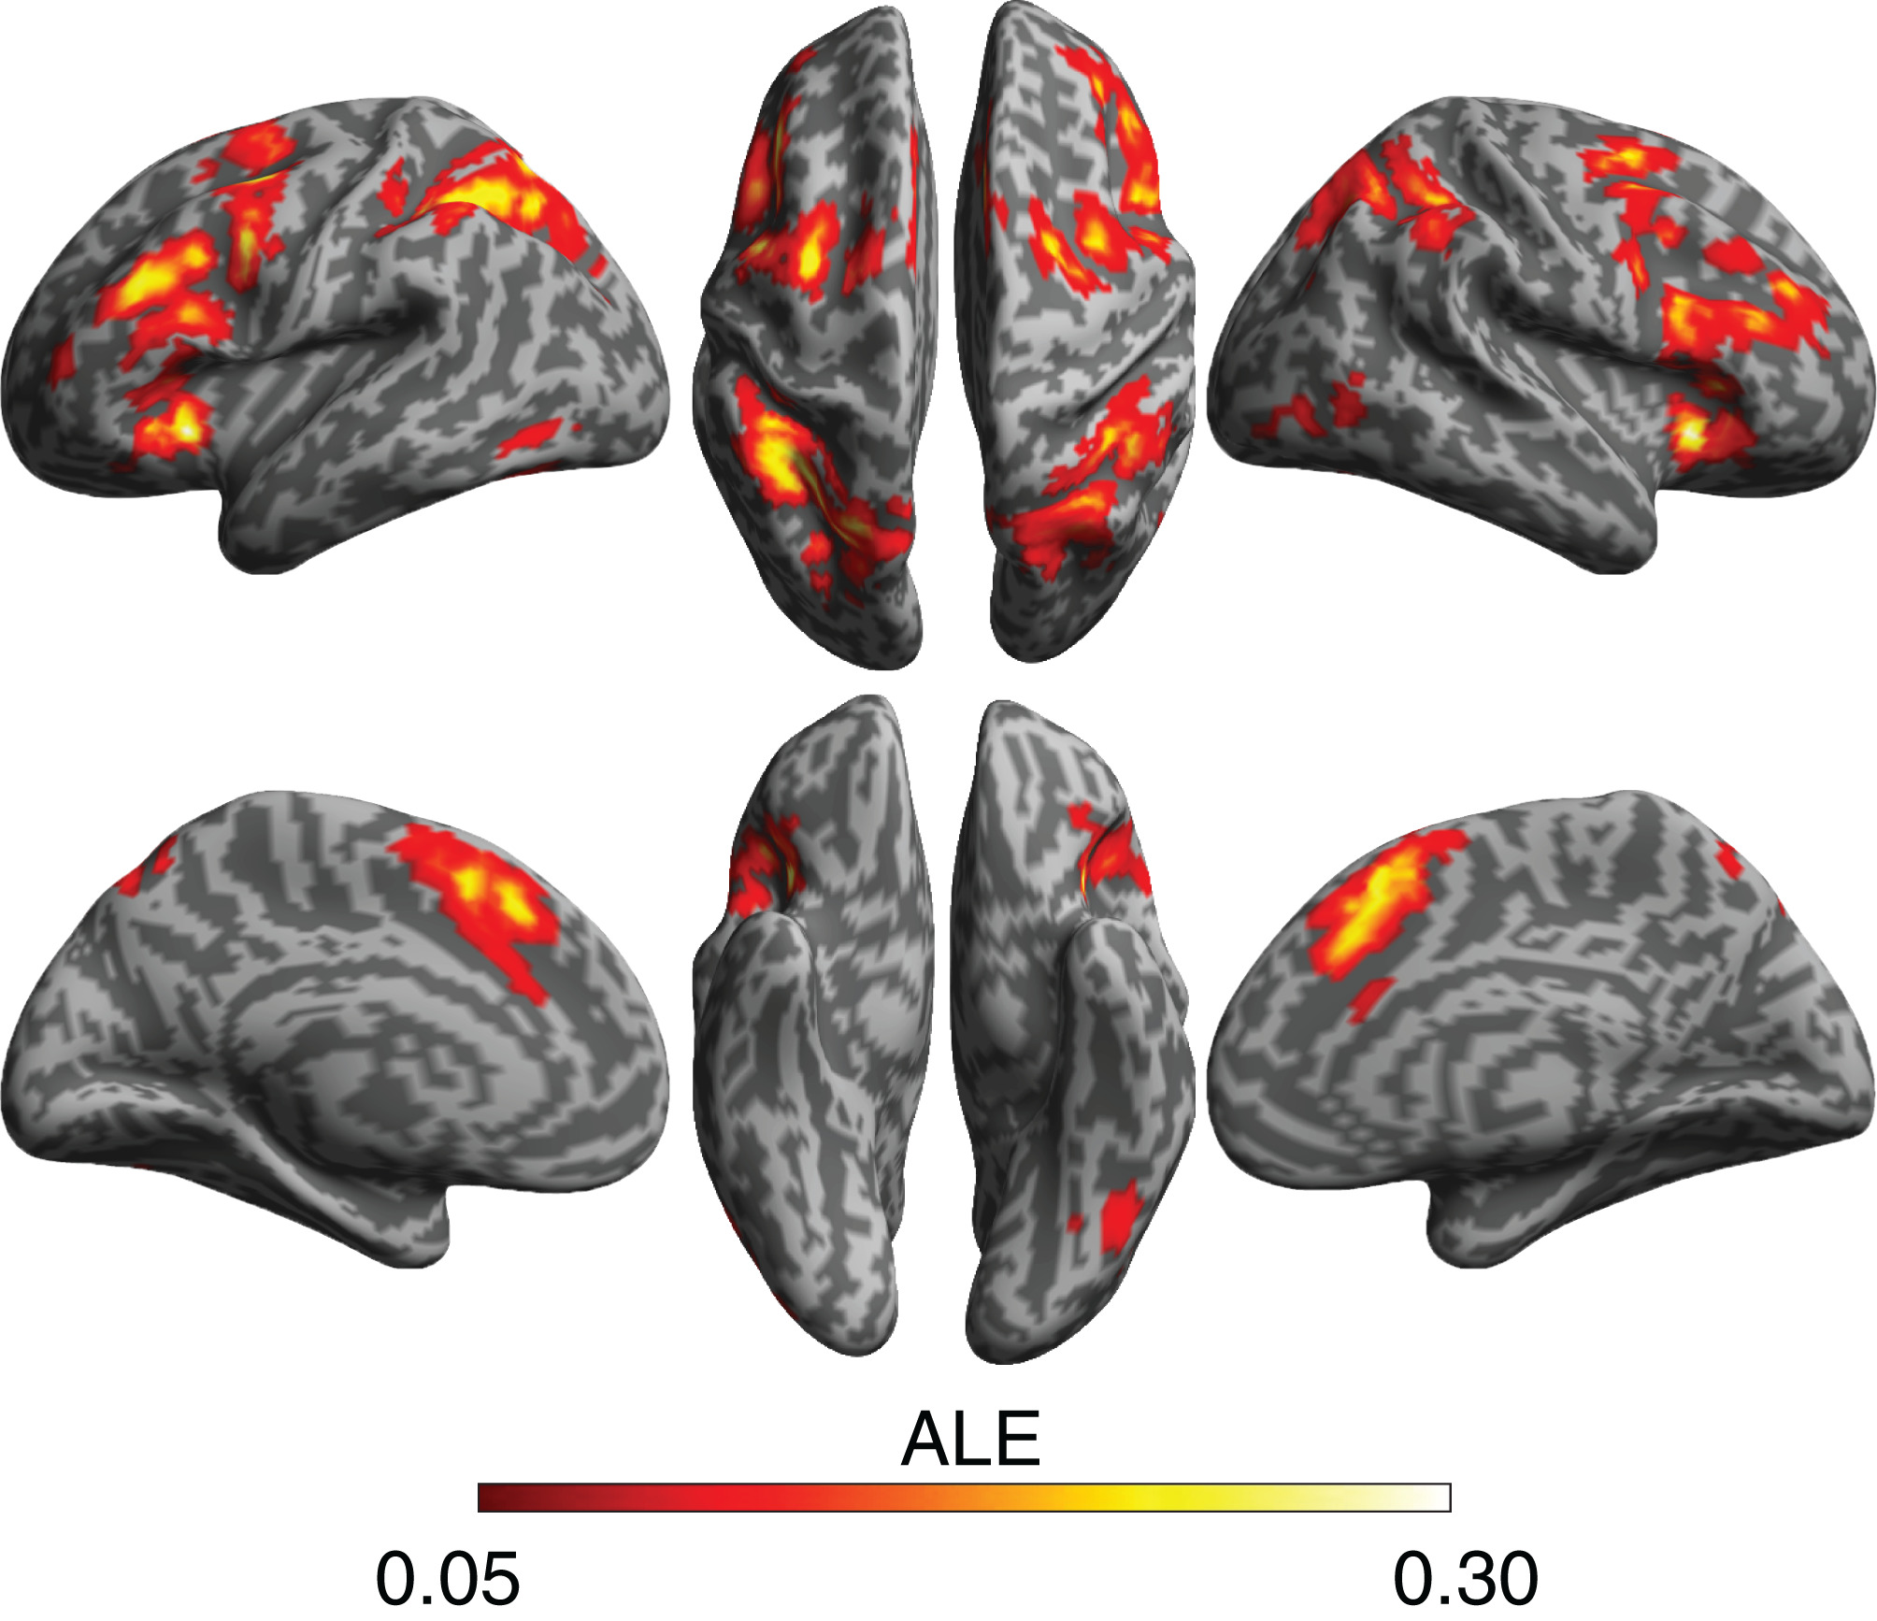
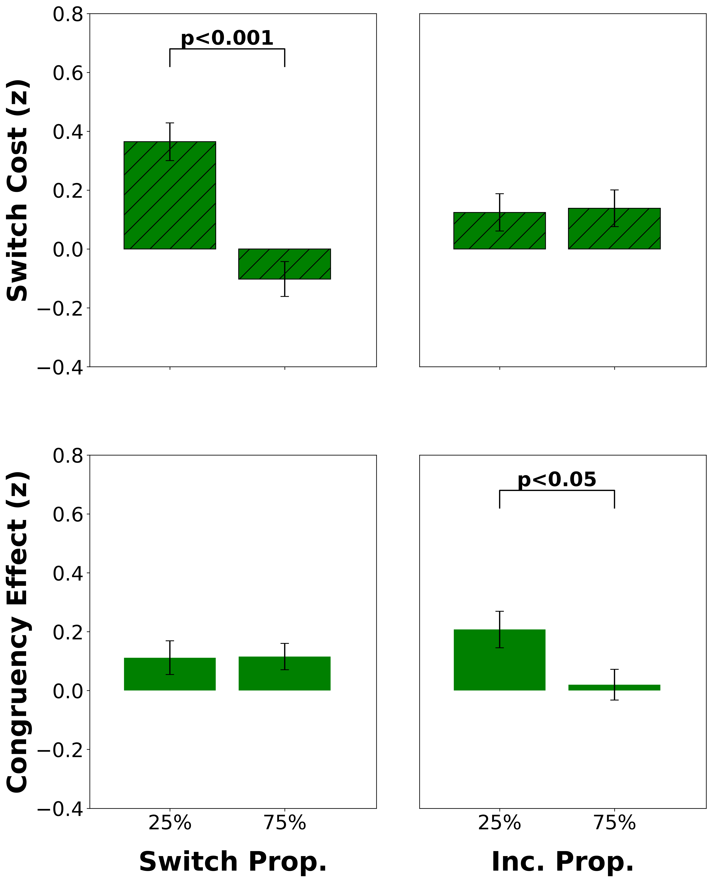
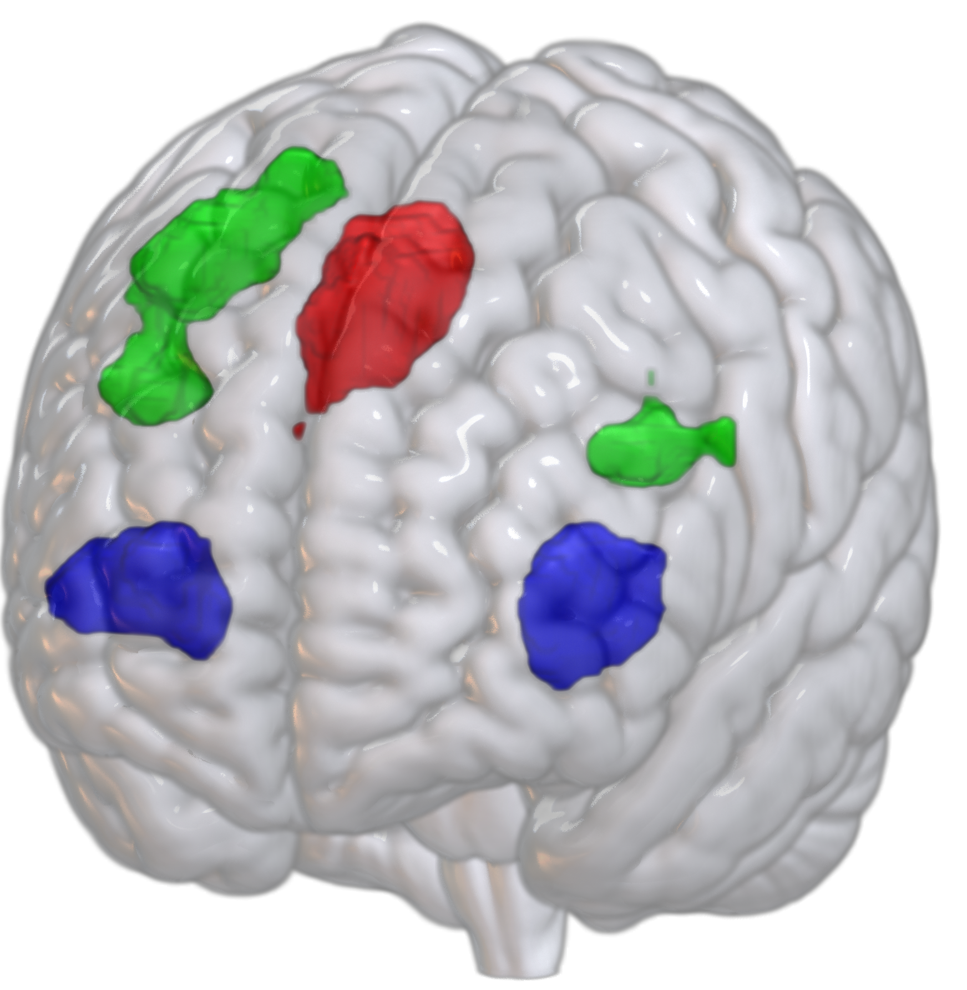
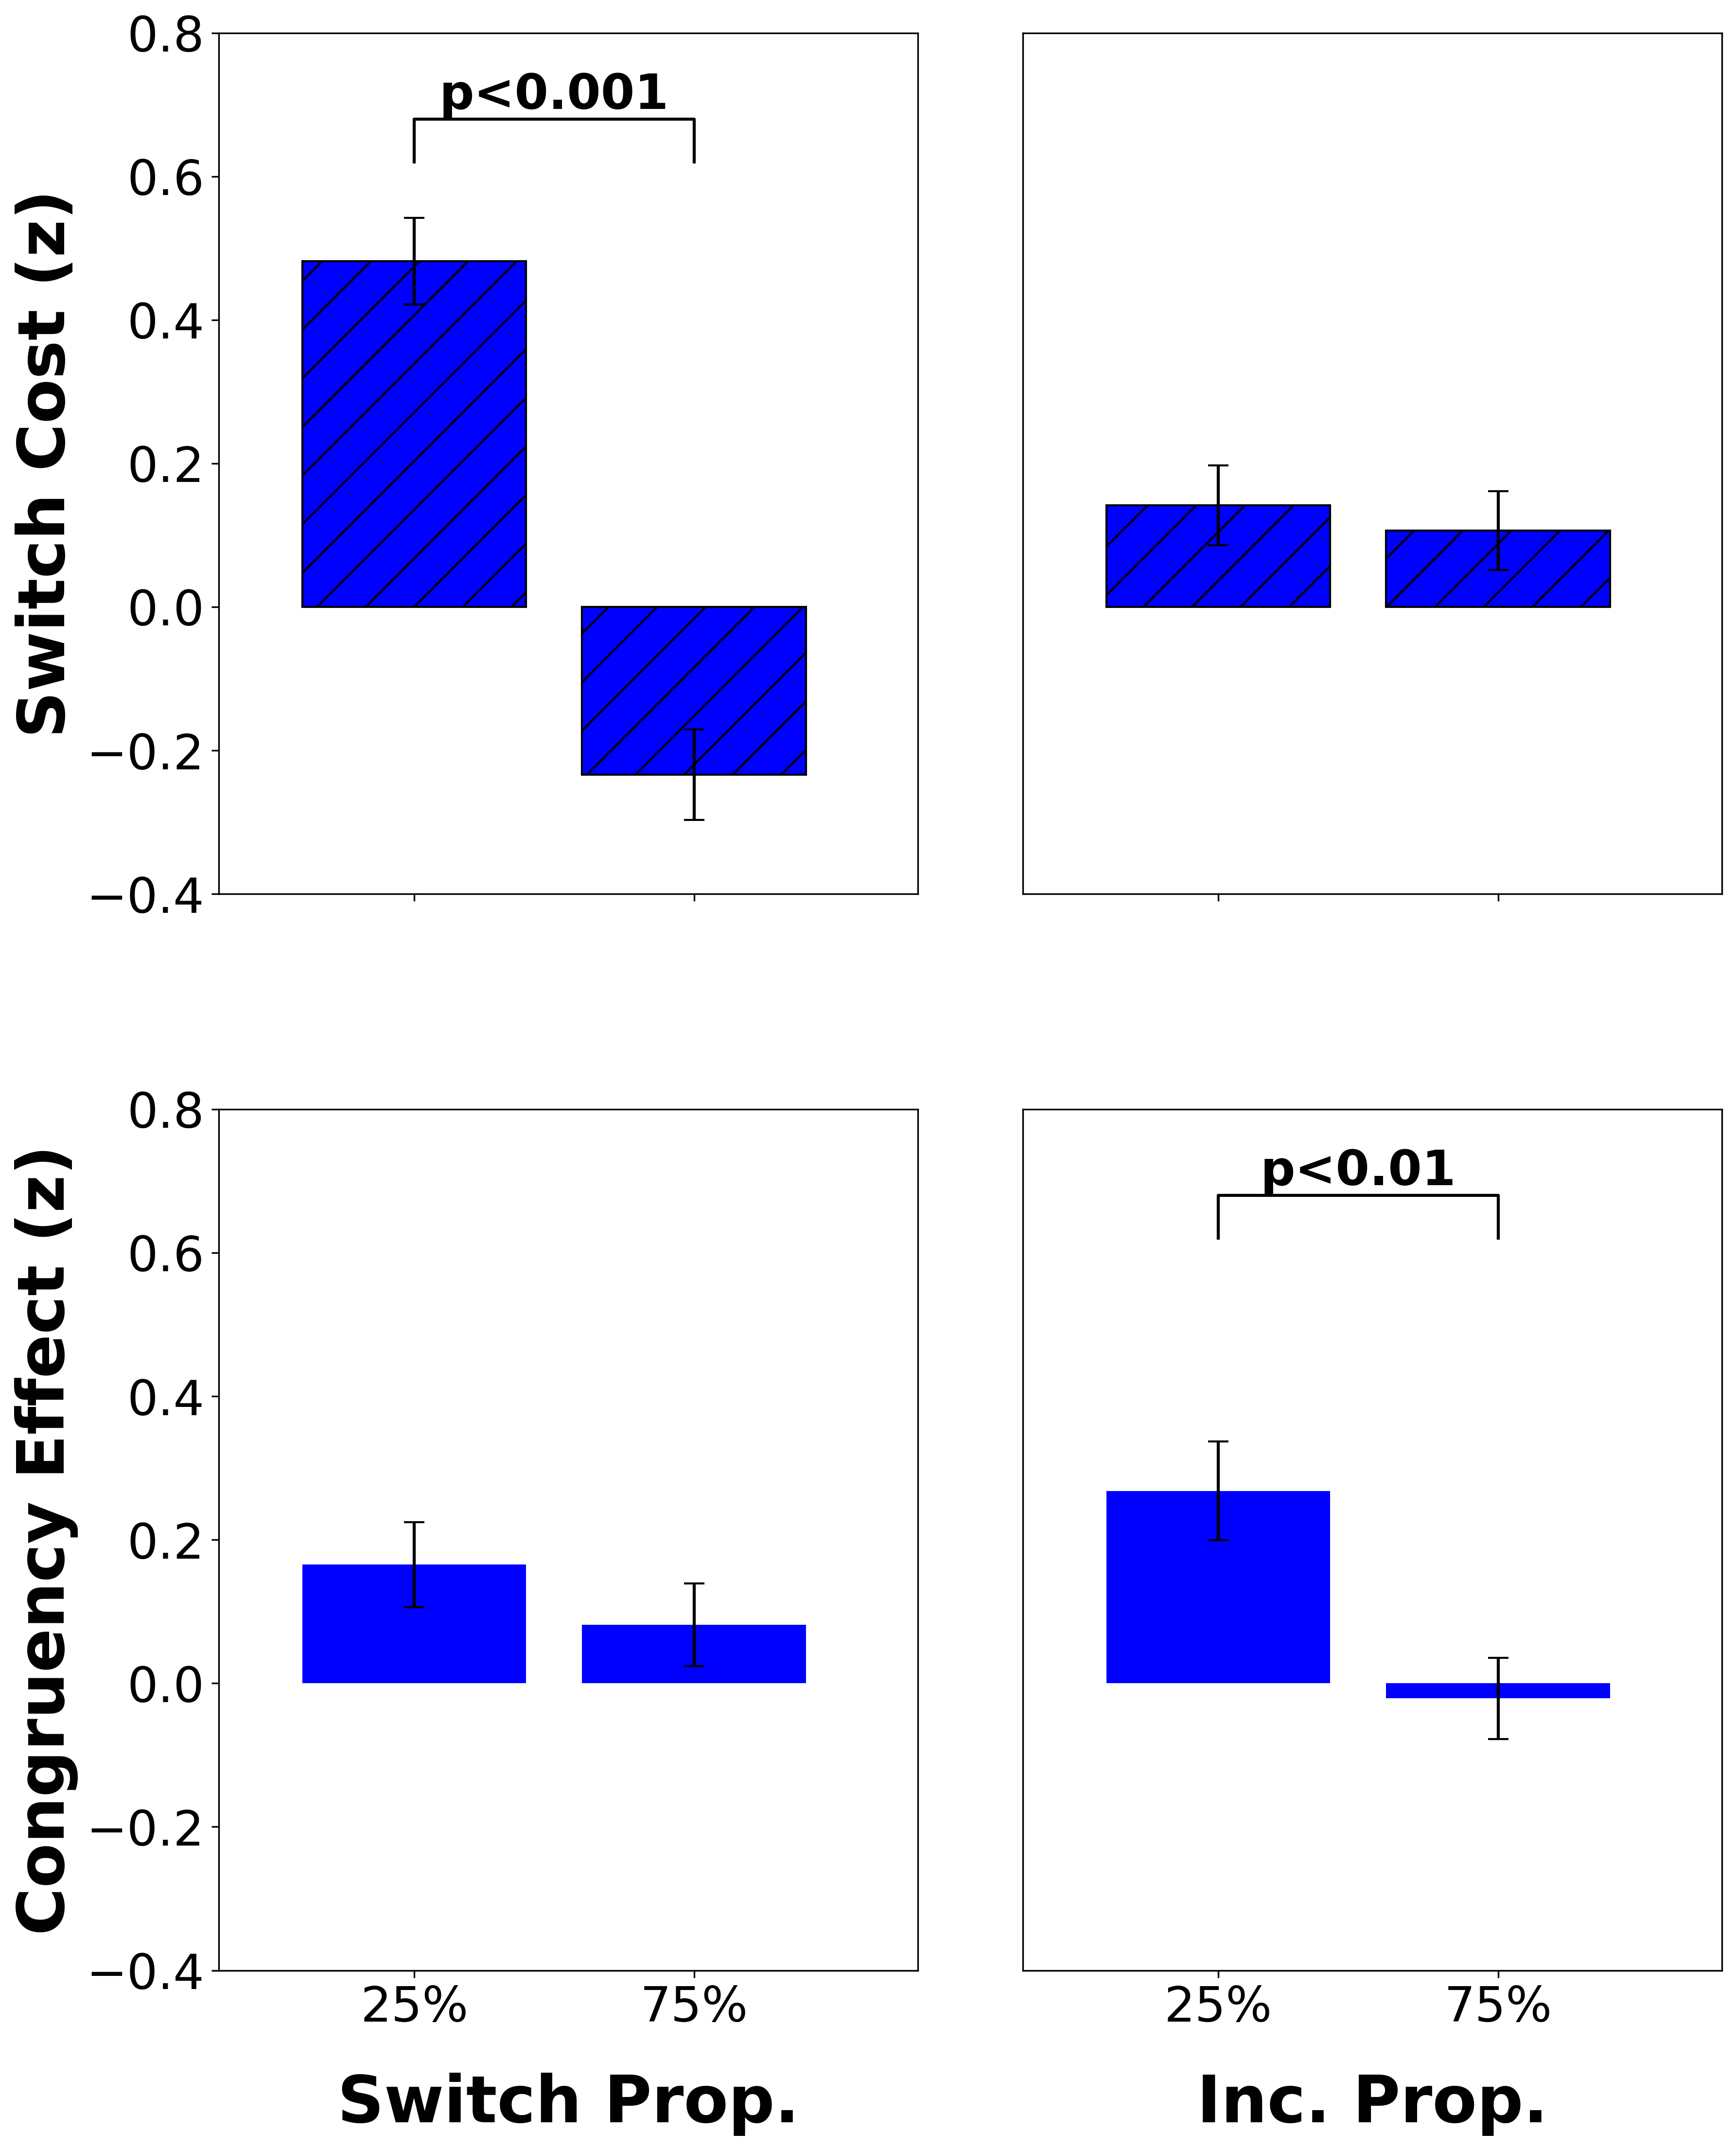
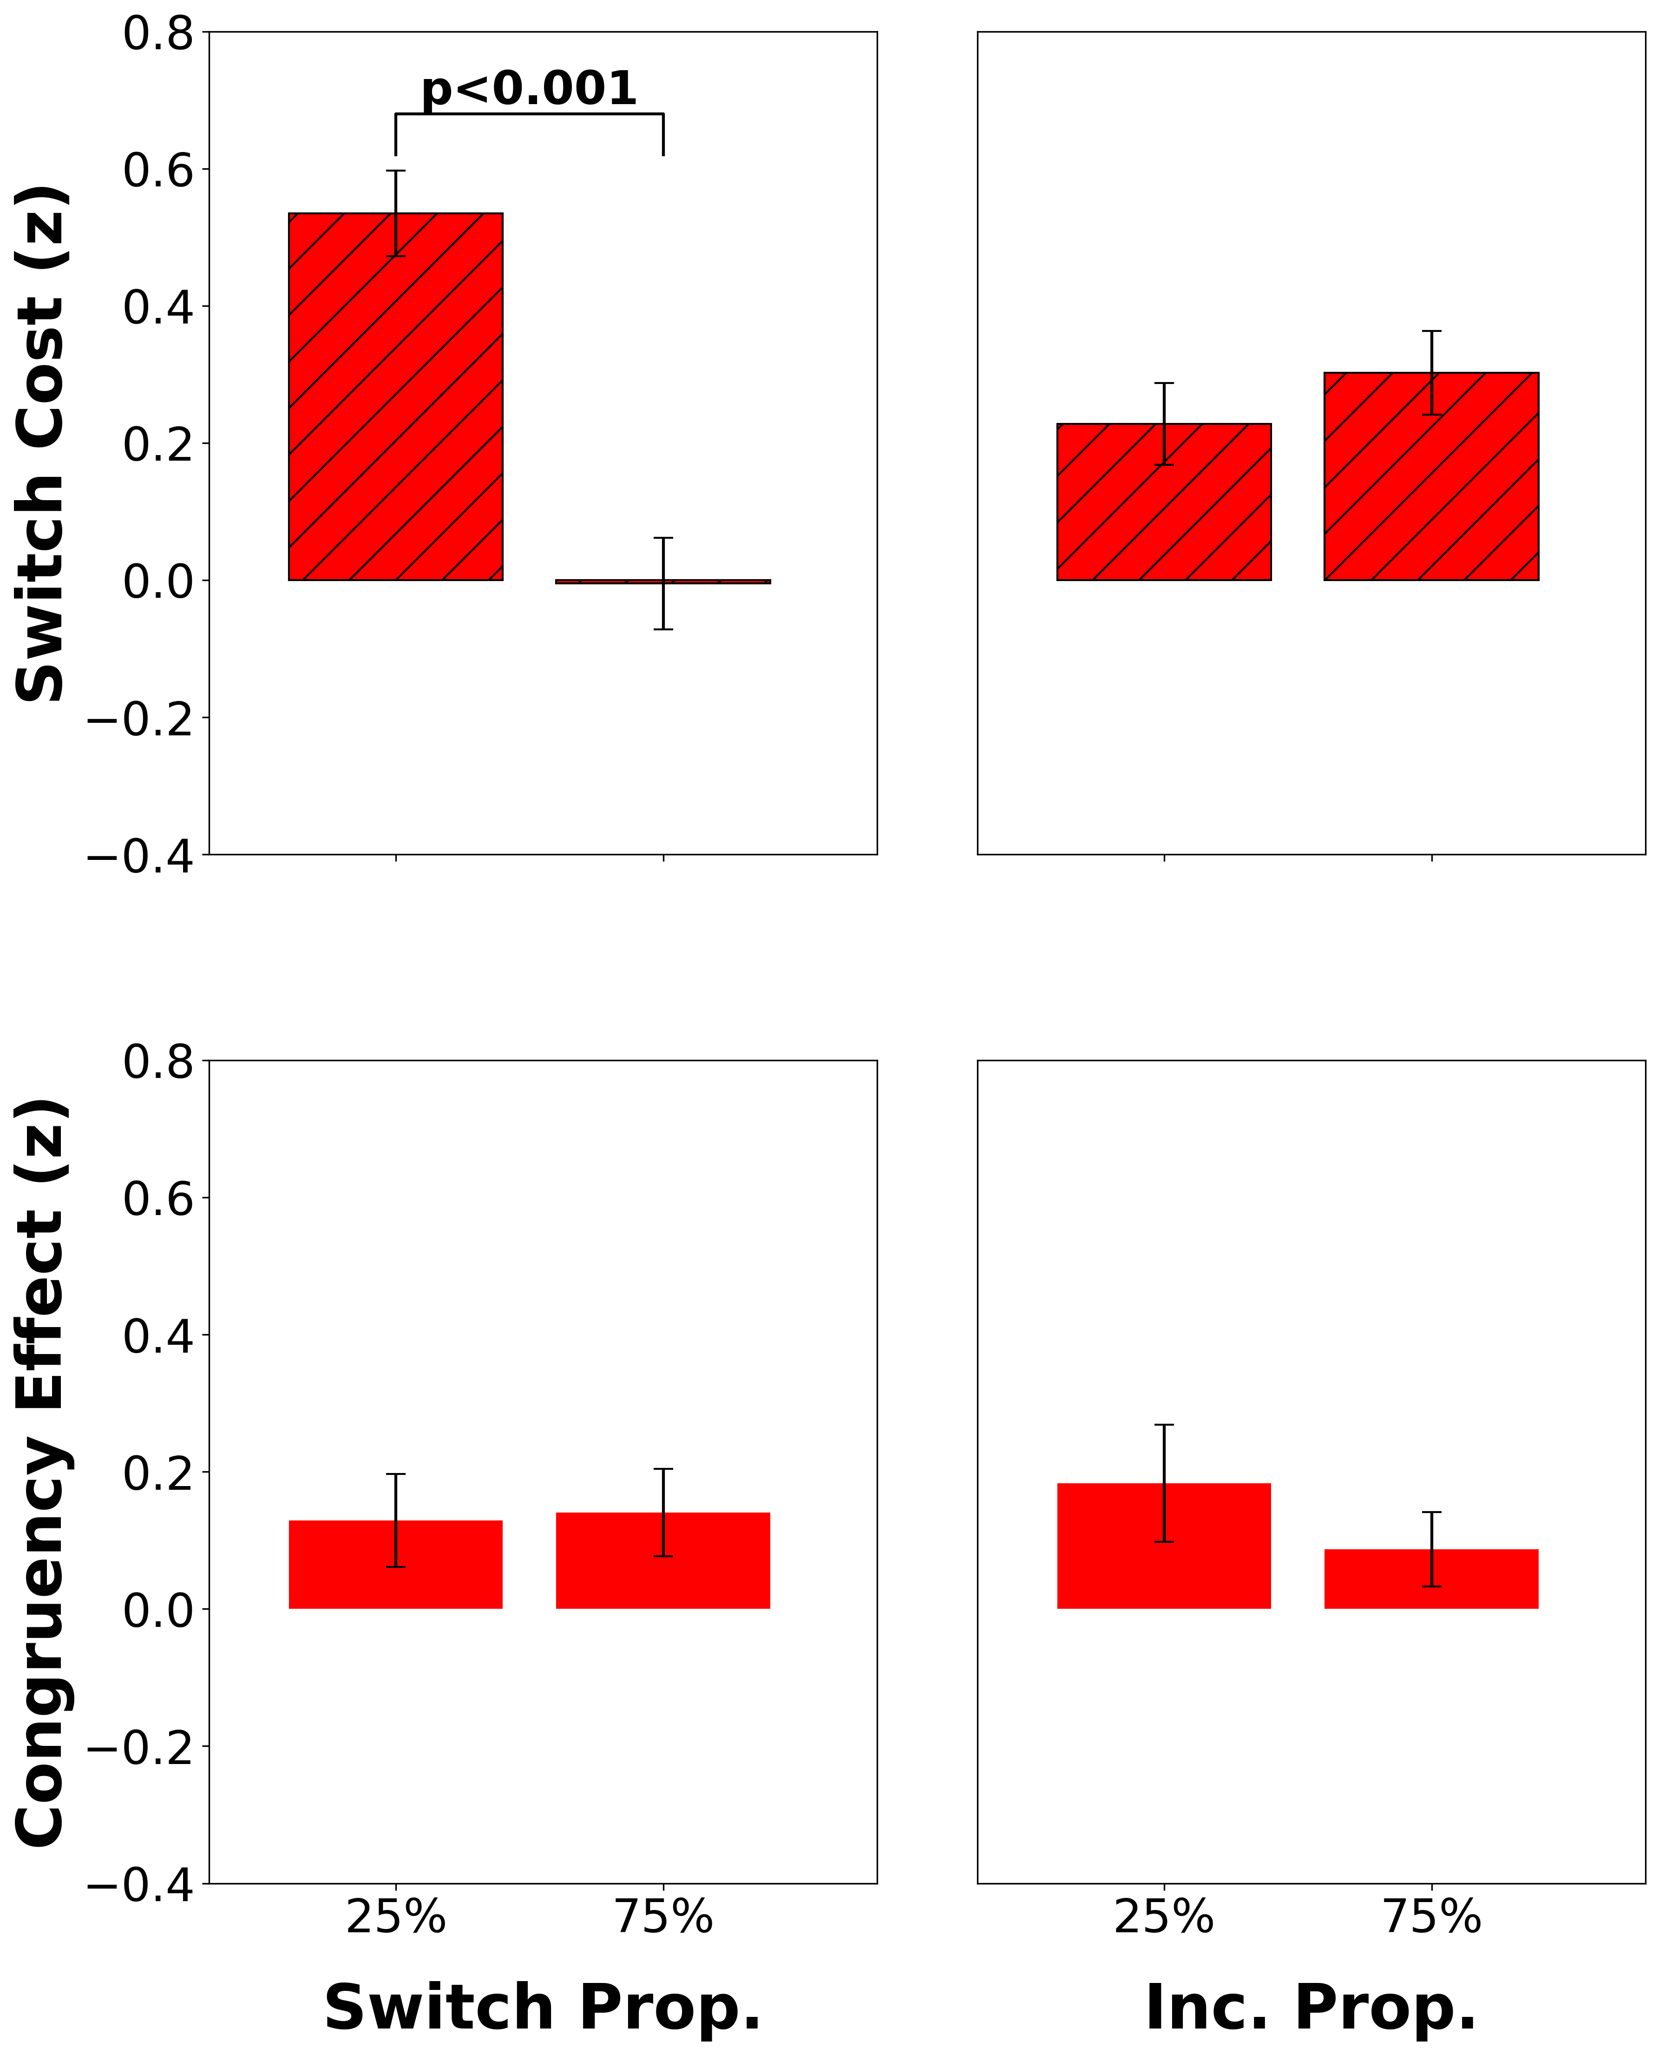

Intracranial EEG Correlates of Concurrent Demands on Cognitive Stability and Flexibility
Neural Correlates of Concurrent Demands on Cognitive
Stability and Flexibility
Jinjiang Zhang^{1,2}, Raphael Geddert^{1,2}, Roshni Ammanamanchi^{1,2}, Andrew Michael², Tobias Egner^{1,2}
Department of Psychology and Neuroscience¹, Center for Cognitive Neuroscience²
Duke University
Background
Behavioral Results
Discussion/Conclusion
Cognitive stability (task focus) and flexibility (task switching) are two core capacities of cognitive control, yet their relationship and neural substrates are unclear^{1,2}
Previous studies have separately shown activation for stability and flexibility in lateral and medial frontal cortex^{3,4}, but whether they have distinct or shared neural substrates is still not known
Do cognitive stability and flexibility have distinct or shared neural substrates?
Switch proportion modulates switch cost
Incongruent proportion modulates congruency effect
ACC uniquely sensitive to flexibility demands, while vlPFC and dlPFC show sensitivity to both stability and flexibility demands
vlPFC/dlPFC results confirm overlapping neural substrates for stability and flexibility but show independent regulation of these processes
Absence of cross-domain effects suggests independence in how stability and flexibility are regulated neurally
Our findings suggest cognitive stability and flexibility rely on partially dissociable neural pathways, with ACC specifically supporting flexibility while vlPFC and dlPFC seem to support both control processes.
This functional specialization could help explain how the brain manages concurrent demands on task focus and task switching.
25%
75%
25%
75%
25%
75%
25%
75%
Neural Substrates of Flexibility³
Neural Substrates of Stability⁴
Switch Prop. Inc. Prop.
Switch Prop. Inc. Prop.
Neuroimaging Results
We identified brain regions mediating cognitive flexibility (via the Listwide Proportion Switch Effect) and probed their response to concurrent stability demands
Independent regulation of stability and flexibility in dlPFC
Methods
Participants completed a classic cued task switching experiment (n=45). Stimuli (1.5s) preceded by jittered ITIs (1-3s) and followed by feedback (1s)
Repeat
Switch
Red Frame: Odd or Even
Future Work
2
7
1
…
Future work should investigate connectivity patterns between regions and brain-behavior correlations
Representational similarity analysis did not show significant multivariate patterns, potentially need alternative multivariate approaches (e.g., MVPA)
Future work should disentangle the concurrent regulation of stability and flexibility in vlPFC/dlPFC
Blue Frame:
< 5 or > 5
Congruent
Incongruent
< 5
even
> 5
odd
👉🏽
< 5
even
> 5
odd
👉🏽
Independent regulation of stability and flexibility in vlPFC
👈🏽
👈🏽
Regulation of flexibility in ACC
Switch costs index flexibility (RT_{switch} – RT_{repeat})
Congruency effects index stability (RT_{inc} – RT_{con})
75%
Block A
64 Trials
Block B
64 Trials
The proportion of incongruent and switch trials varied independently across block types
Proportion x main effect interactions to reveal how these processes are regulated
2 blocks per functional run, 4 runs total
Switch Prop.
References
25%
Block C
64 Trials
Block D
64 Trials
Egner 2023, Nat Rev Psychol.
Geddert and Egner 2022, Journal of Experimental Psychology.
Worringer et al. 2019, Brain Struct Funct.
Wu et al. 2020, J Comp Neurol.
Thanks to all members of the Egner lab for their guidance and support on this project
This work was funded by NIH Grant RO1 MH133550
25%
75%
Incongruent Prop.
Analyses and standard preprocessing conducted in FSL.
Cluster-forming threshold of z=2.3 and cluster significance threshold of p=0.05.
Event-related modelling used for task conditions.
CONTACT
jim.zhang@duke.edu
CONTACT
jim.zhang@duke.edu

